Slide 1
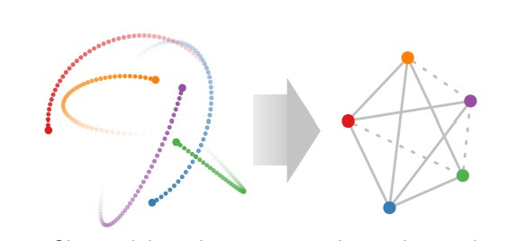
Neural Relational Inference for Interacting Systems
Thomas Kipf* Ethan Fetaya* Kuan-Chieh Wang Max Welling Richard Zemel
Notes:
*Equal contribution

Slide 2
What is it?
Use VAE and GNN to infer relations/edges/connectivity between systems/nodes/components.

Slide 3
Outline
VAE
GNN
Paper motivation
Method/Architecture
Results
Does it work?

Slide 4
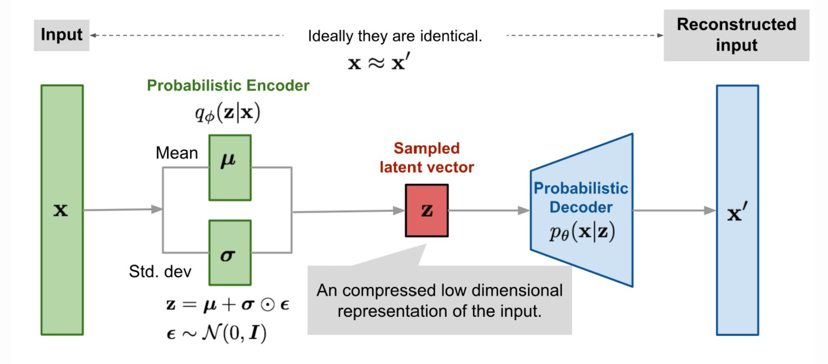
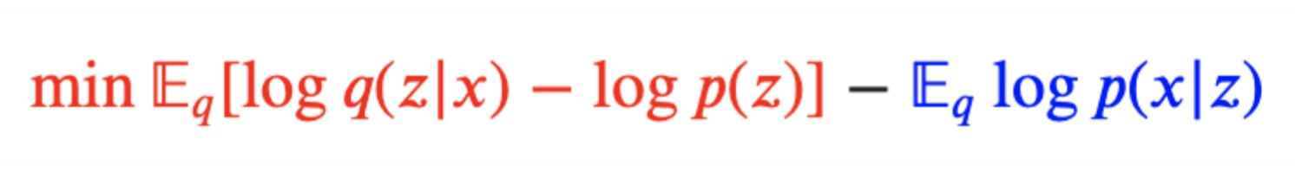
VAE
Notes:
From Autoencoder to Beta-VAE (lilianweng.github.io) Variational Autoencoder Demystified With PyTorch Implementation. | by William Falcon | Towards Data Science Deep Learning 19: (1) Variational AutoEncoder : Introduction and Probability Refresher - YouTube

Slide 5
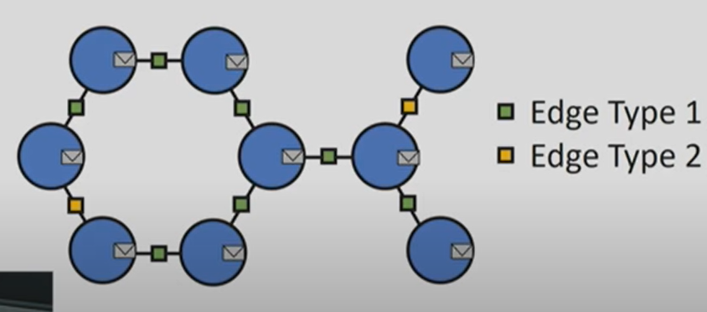
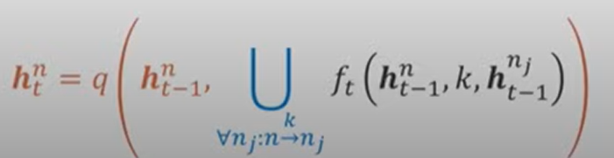
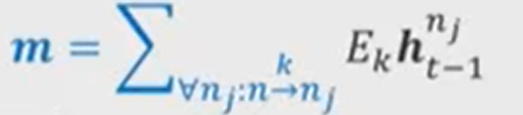
GNN
Notes:
An Introduction to Graph Neural Networks: Models and Applications – YouTube
Graph neural networks: Variations and applications - YouTube

Slide 6
My talk / Paper’s motivation
GNN has worked in many fields. E.g., Drug discovery, interactive systems, classification node/graph and many others.
Sometimes, we don’t have underlying relations between objects.
Can GNN help us infer the relations?
Will the inferred relations help us in classification and other downstream tasks?

Slide 7
Method / Architecture
Encoder: Learn h_ij instead of µ. h_ij represents the embedding of edge between node i and j.
Sampling: Sample latent variable z from h same as VAE but z is discrete not normal. It represents the edge type between two nodes.
z_(ij) ~ Categorical(softmax(h_(i,j)))
Decoder: Use decoder to predict x_(t+n) given x_t and z.

Slide 8
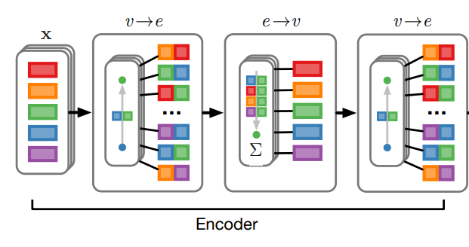
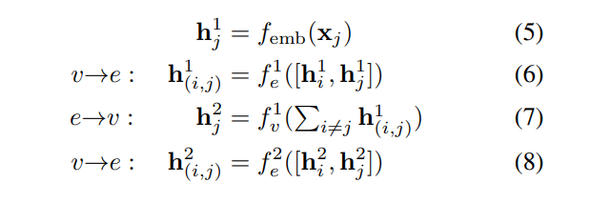
Encoder

Slide 9
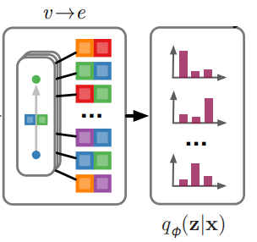

sampling

Slide 10
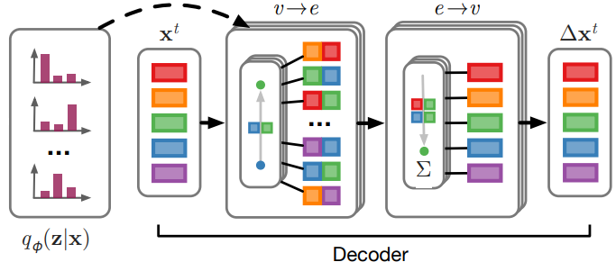
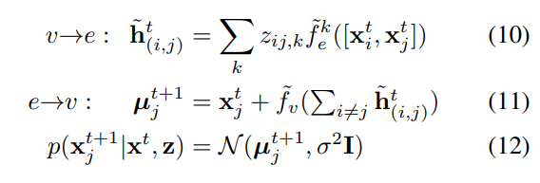
Decoder

Slide 11
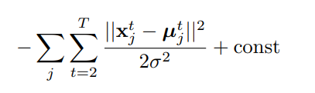
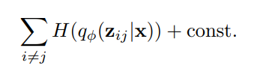
Loss

Slide 12
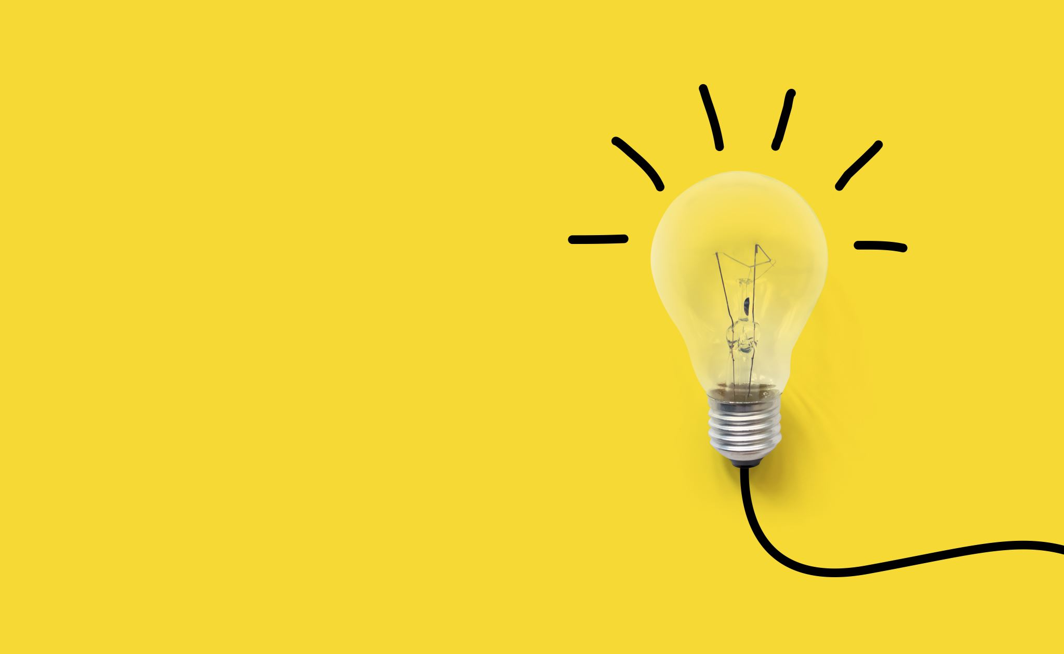
Results

Slide 13
Does it work?

